Slide 1
Langley Home Furnishings
Where Elegance Is Culture

Slide 2
ABOUT US
High-End International Customizable Home Furniture Store:
Langley Home Furnishings is a furnishing store which deals in high-end luxury customizable furniture especially for Canada and customers across the globe. We provide all types of home furniture designs which are handcrafted to perfection. Our experienced carpenters make customizable furniture for their customers who are looking for elegance and luxury. We offer a complete variety of furniture with outstanding designs made with your choice of materials.
Who are we?
We are one of the best home furnishing store dealing in a complete range of home furniture . Our motto is to provide you best quality furnishing materials which will upgrade your home interior design. Also, we believe in delivering the perfect piece of furniture every time you order anywhere you want.
What do we do?
Langley home furnishing produces remarkable luxury furniture pieces with various style ranges to choose from such as neo classic, modern, classic etc. we provide high-quality furniture pieces for all the spaces of your house such as kitchen, bedroom, dining room, living room including the tiny home décor details and accessories. We deliver furniture to your doorsteps and ship all over the world with installation services in selected areas.
What do we offer?
We showcase selected handcrafted furniture pieces carpentered to perfection from finest quality fabrics and materials. We provide luxury home furnishing pieces in reasonable prices which not only goes well with your interior taste but also up to date with latest interior trends.

Slide 3
Projects
APARTMENT RENOVATION
CLASSIC FURNISHING
ECO GREEN INTERIOR
LUXURY LIVING ROOM
MODERN ELEGANCE SUIT
OFFICE ON SPACE
SUMMER HOUSE
RESTAURANT FURNISHING

Slide 4
SHOP
SECTIONAL
SOFA SET
PULLOUT
BED FRAME
DINING TABLE
OTTOMAN
ACCENT CHAIR
CENTRE TABLE

Slide 5
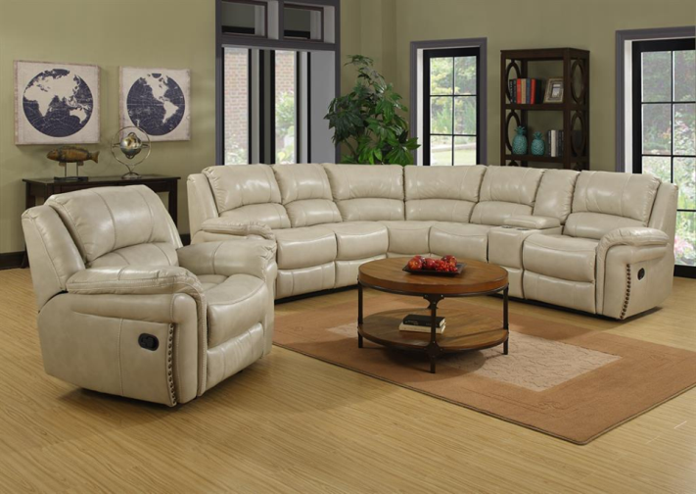
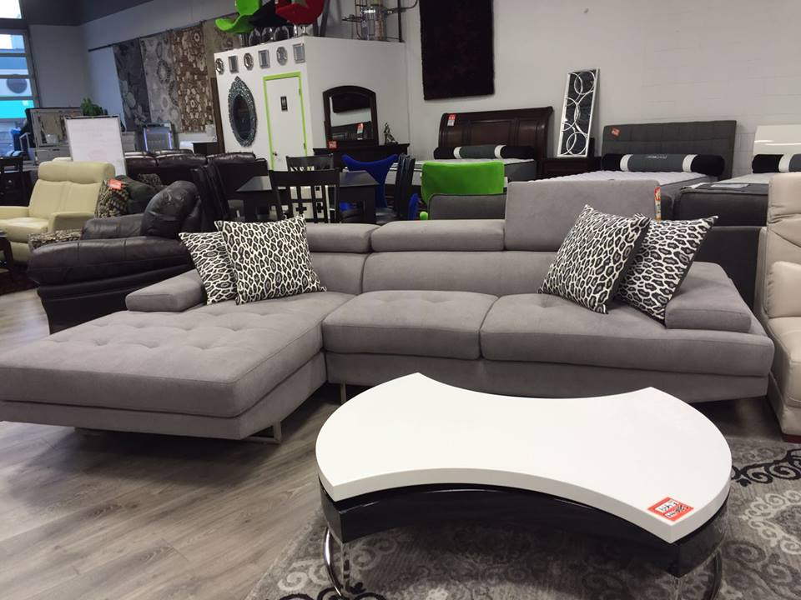
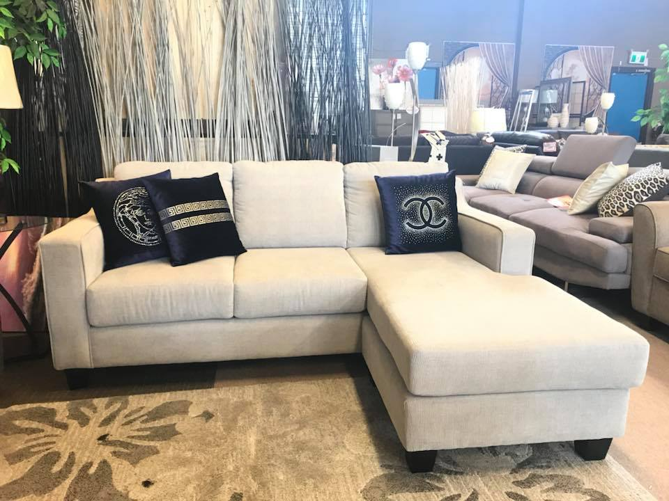
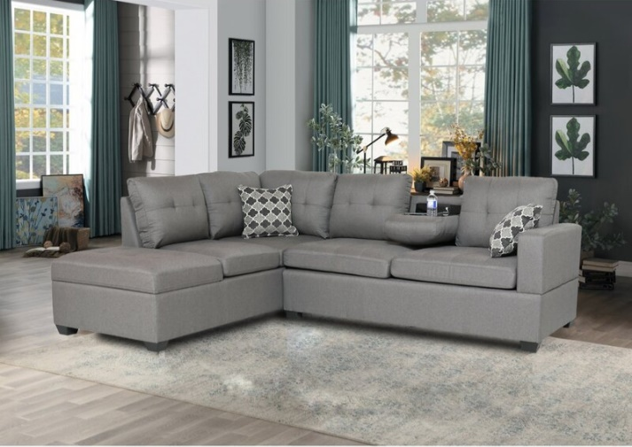
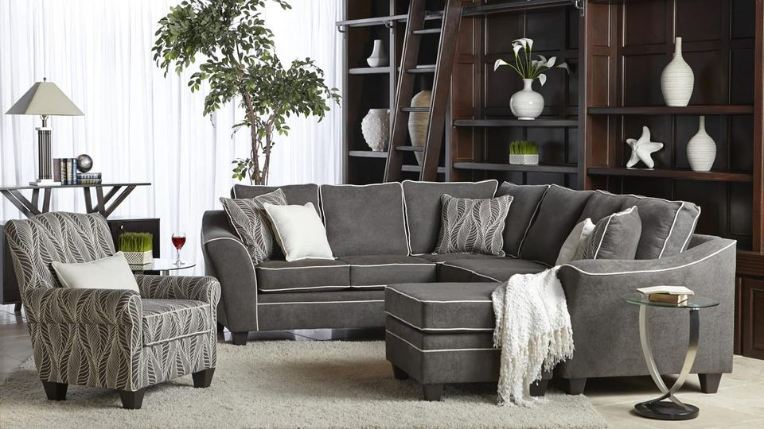
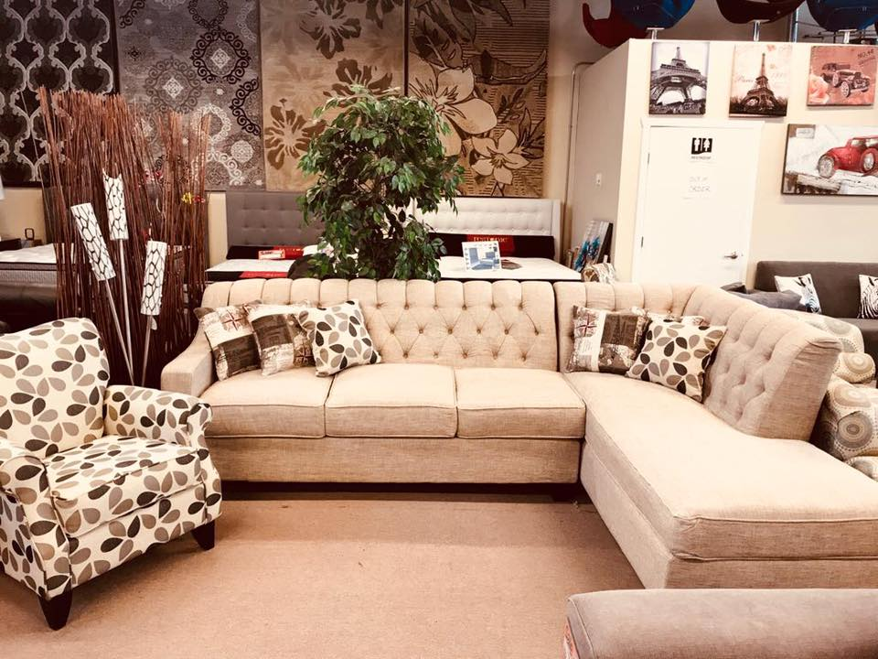
SECTIONAL
Starts from $599
Blossom – Sectional 155
Bubble – The Sectional
Feather – FR 101
Greyline RHS Series 5
Sapphire – Sectional DRD100
Harmony – Comfort 360

Slide 6
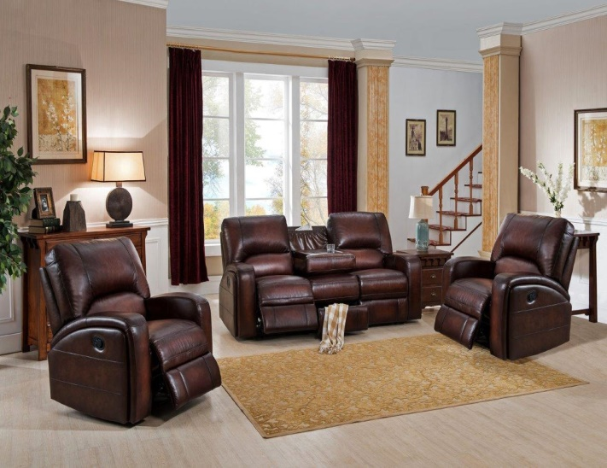
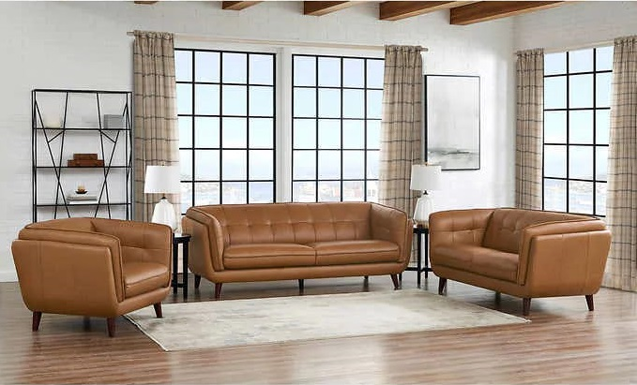
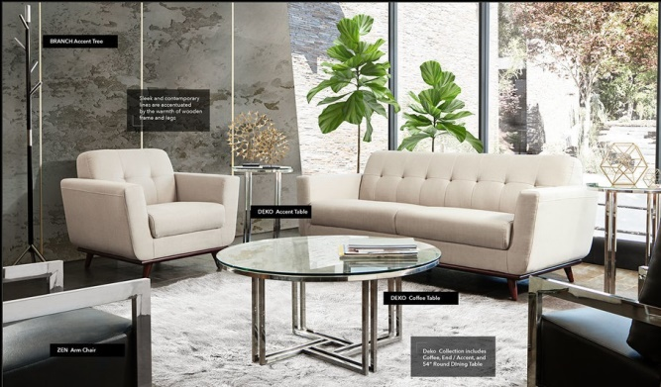
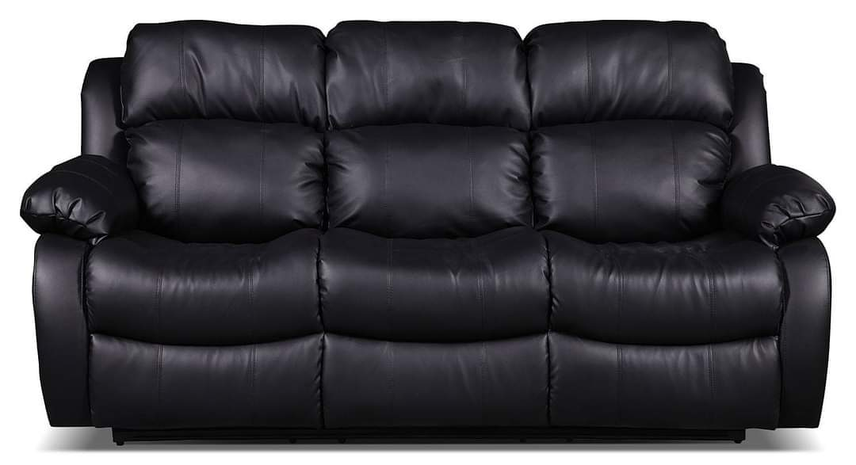
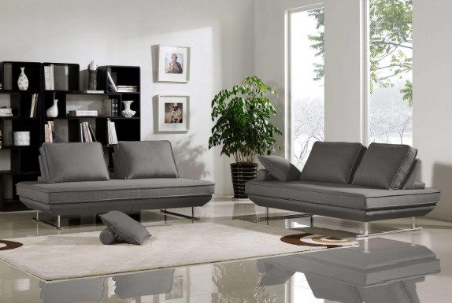
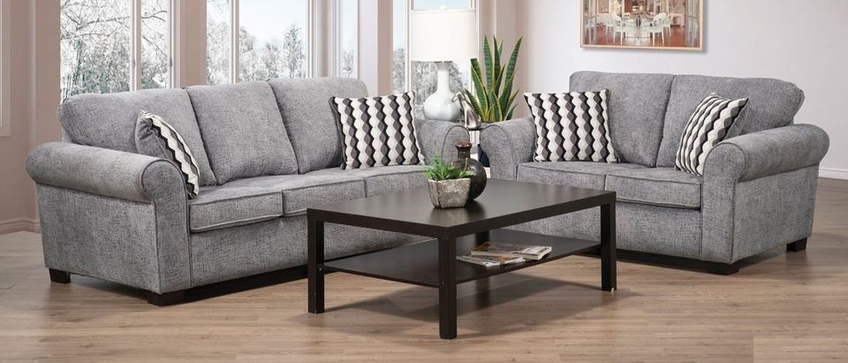
SOFA SET
Starts from $399
Summerlands Leather Power Motion
Top Grain Leather SRT-101
Snow Delta – Canadian Made
Dark Leatherette Sofa Series 3
Carbon Black sofa
Brisk – Boulevard 119

Slide 7
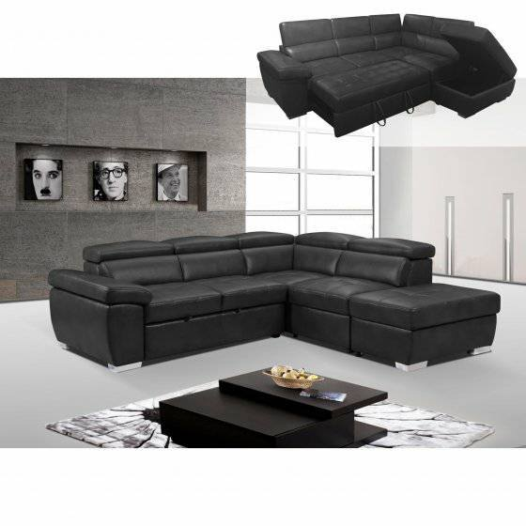
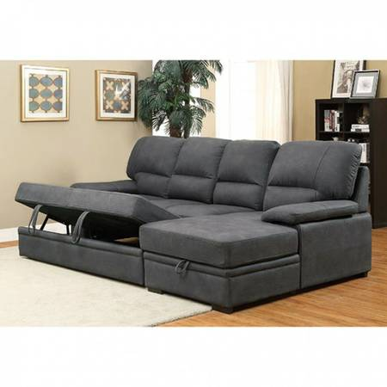
PULLOUT
Starts from $699
Black Leatherette Pull Out
Greyline pull out 1

Slide 8
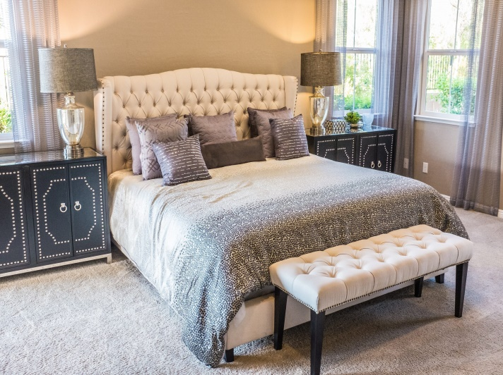
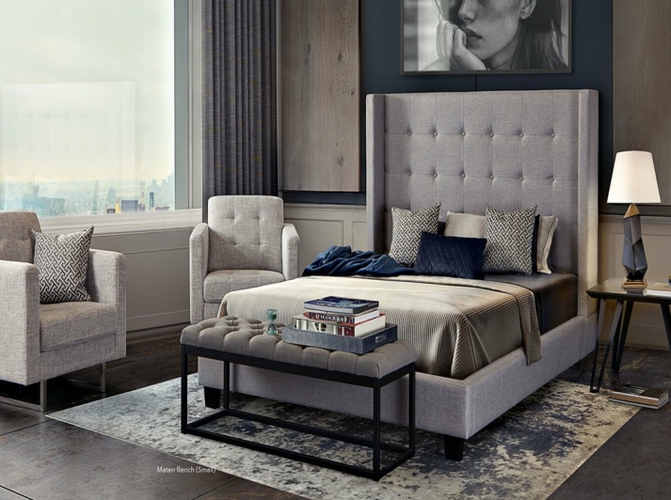
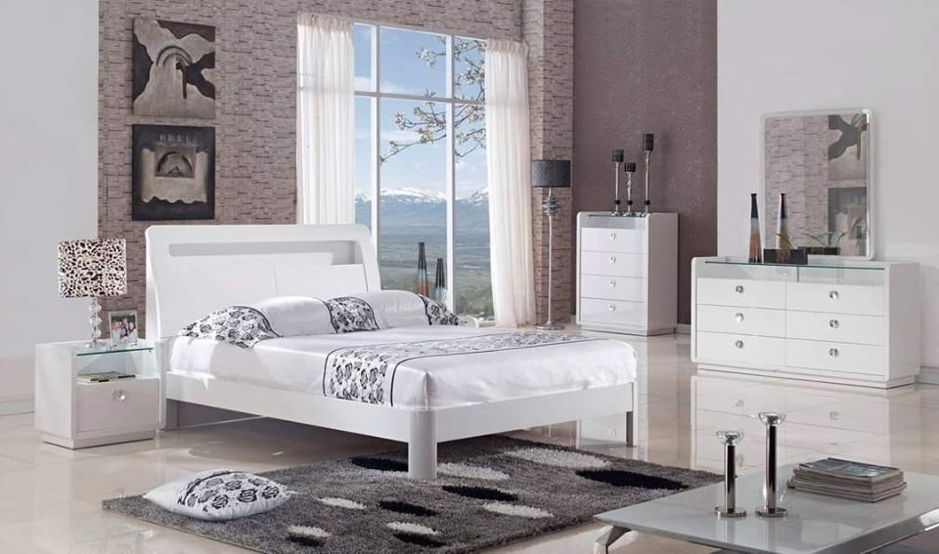
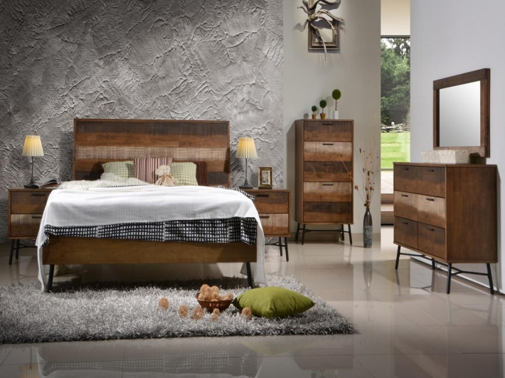
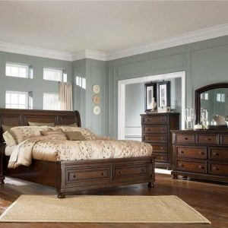
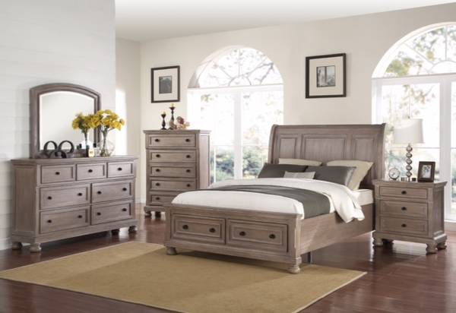
BED FRAME
Starts from $499
Achromatic W1 Bed
Grizzled W1 Series LE
Royal King Size Bed
Hazel Brown Bed D1
Beige Harbor – HK101
Mild Wood Bed

Slide 9
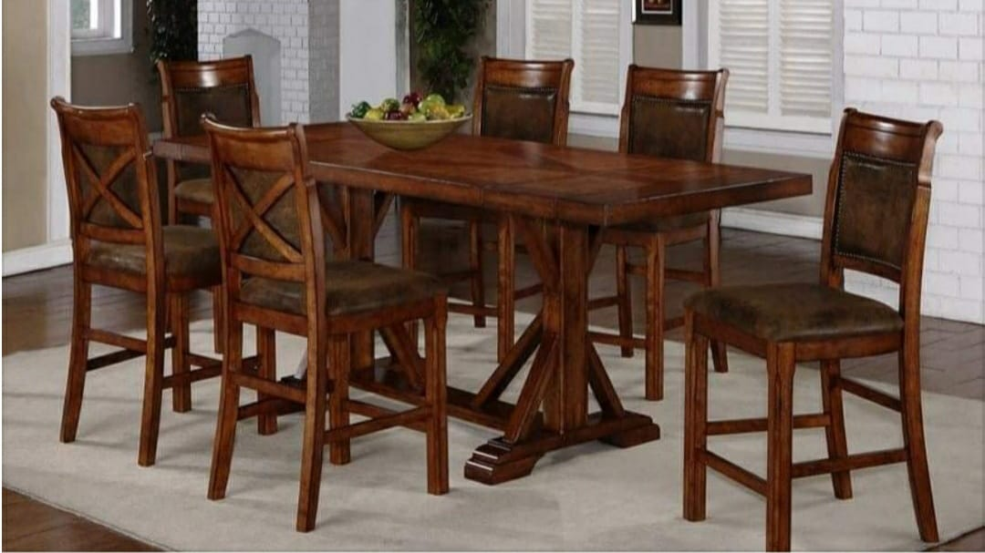
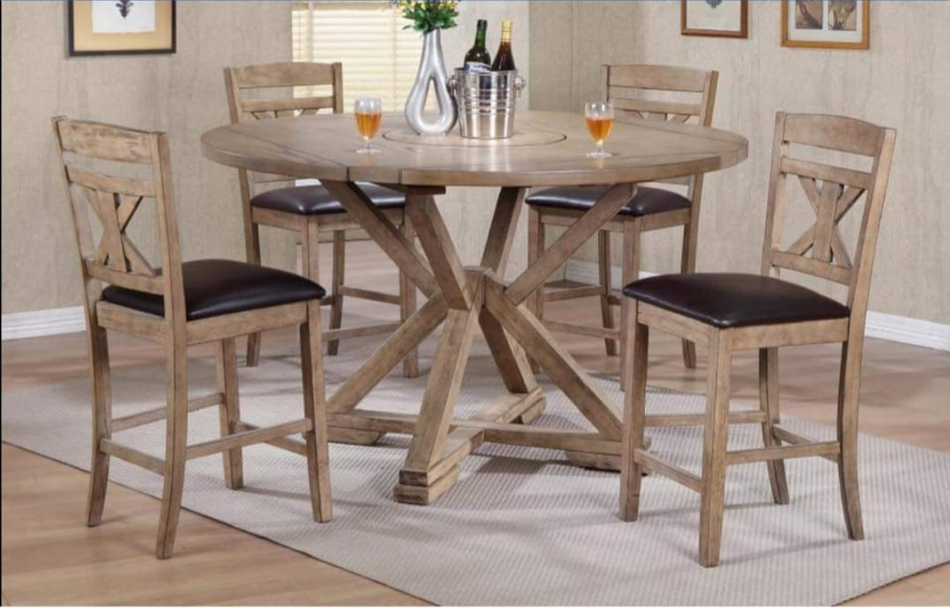
DINING TABLE
Starts from $399
Solid Wood Dining Table Series 4
Solid Wood Dining Table Series 6

Slide 10
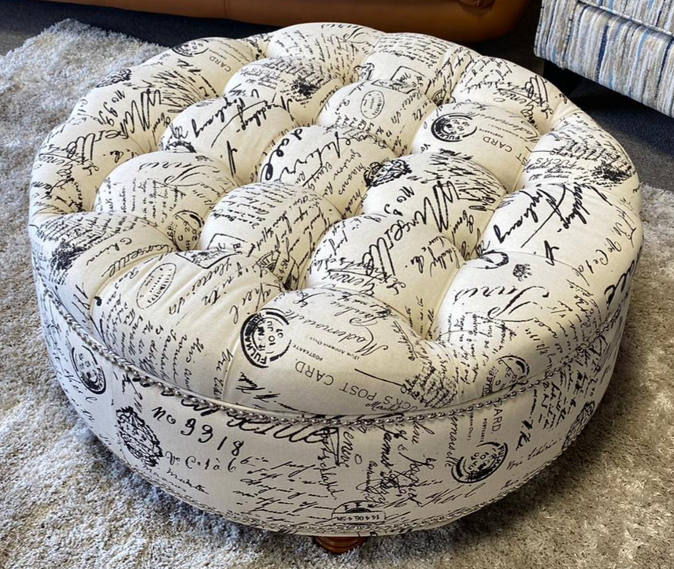
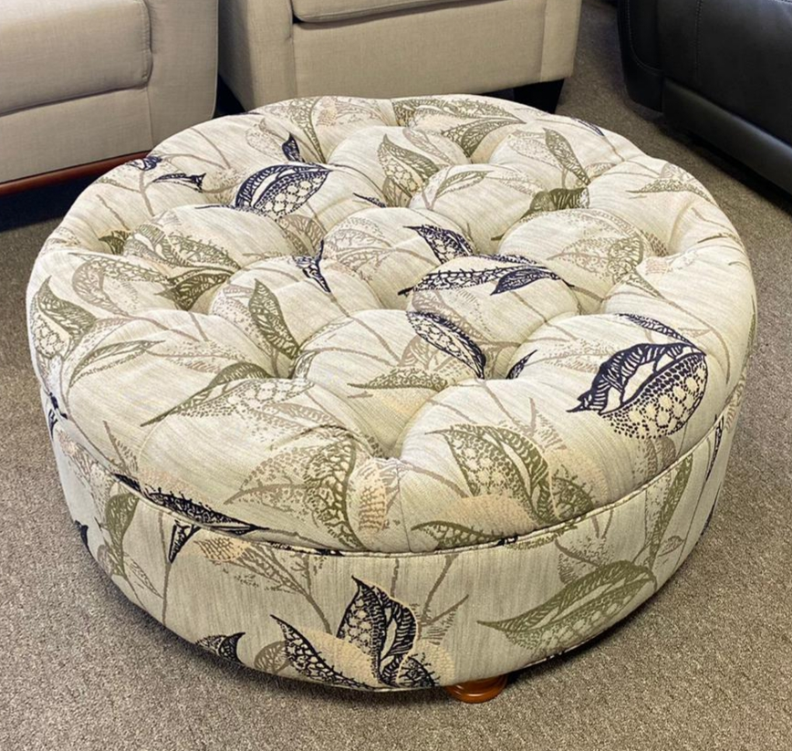
OTTOMAN
Starts from $199
Canvas Round Ottoman
Canvas Round Ottoman 2

Slide 11
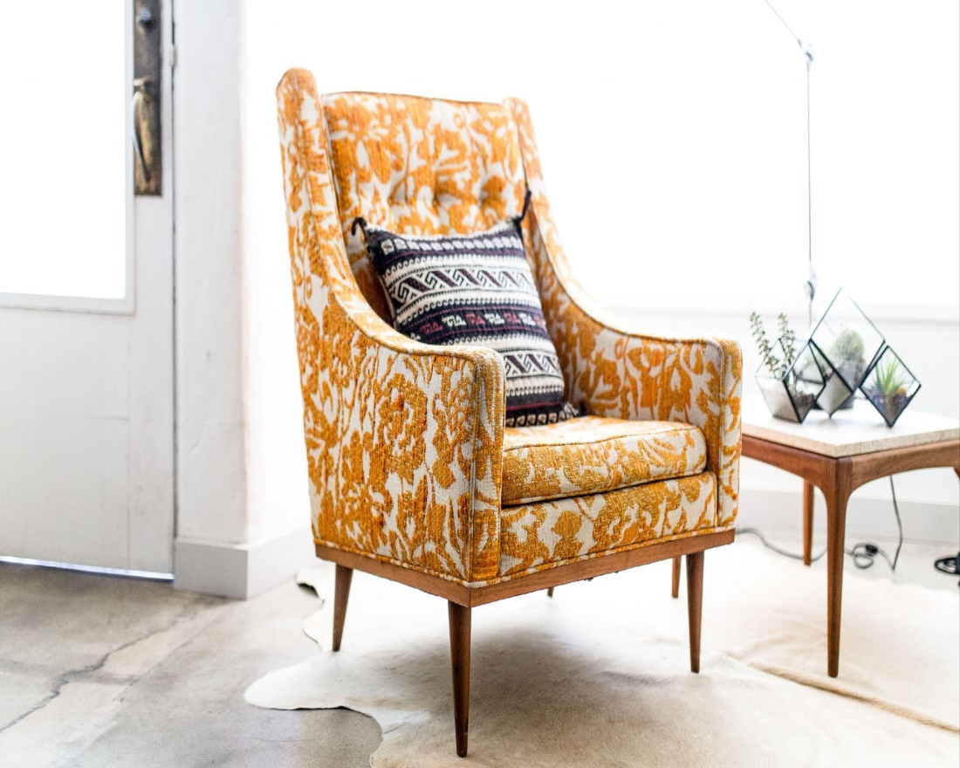
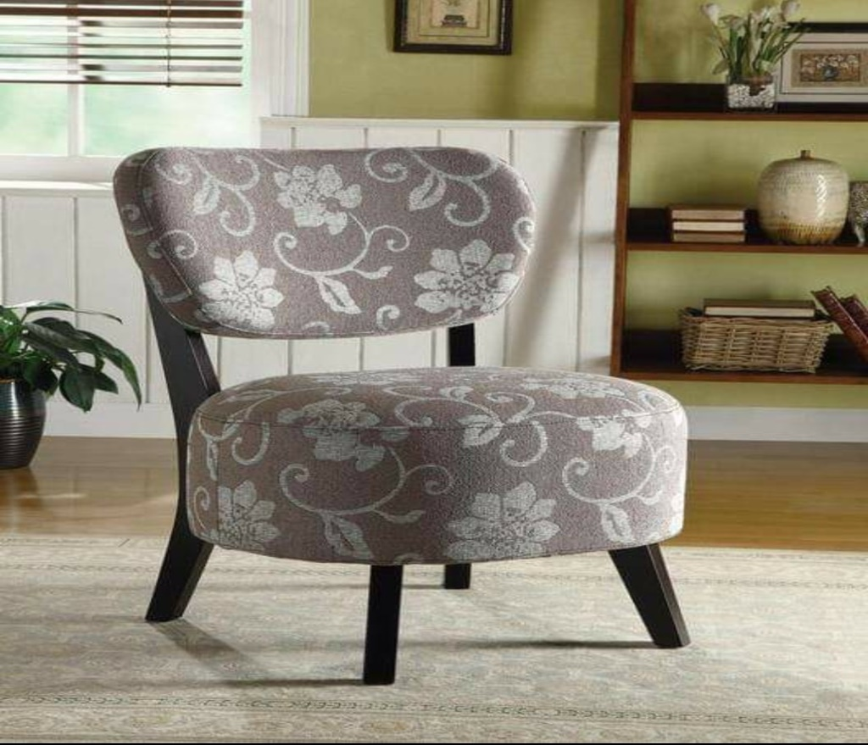
ACCENT CHAIR
Starts from $299
Heritage Accent Chair
Nano Accent Chair 1

Slide 12
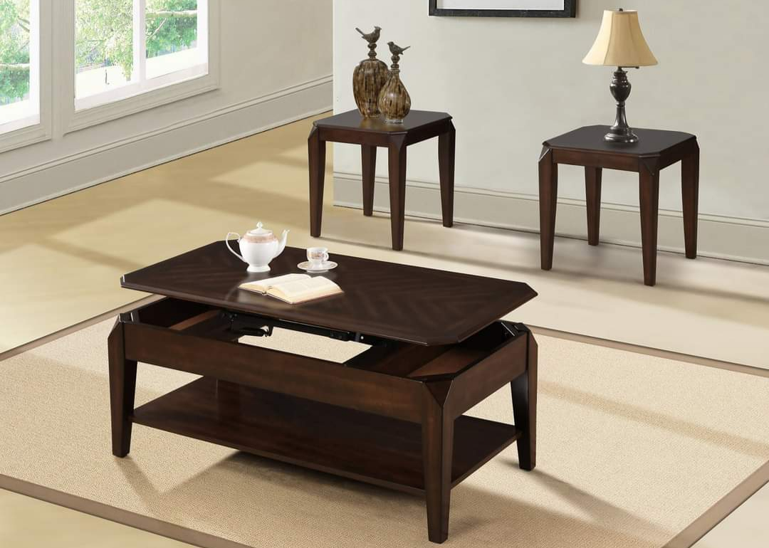
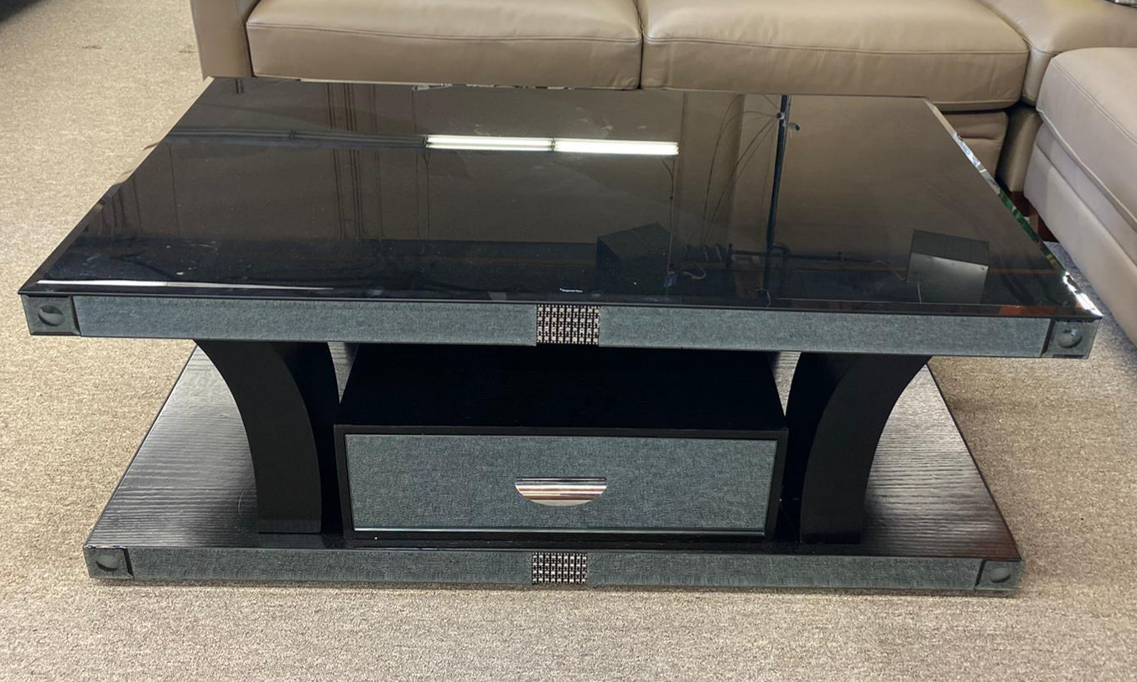
CENTRE TABLE
Starts from $199
Darkwood Centre Coffee Table
Vitreous Centre Table

Slide 13
WHY CHOOSE US?
Interior Expertise
We provide you furniture pieces with intense interior taste and classy touch so that you don’t have to pick your home furniture randomly.
Creative Designs
Our designs are unique and innovative, something which is not available at every store. Each furniture is designed to perfection to make an outstanding classy piece.
REASONABLE PRICE
Pay the right price for our high-quality product. We offer outstanding furniture pieces at affordable prices so that you can afford elegance reasonably.
Free Consultation
Our interior designers provide you a free consultation about the product, your interior designs choices and help you make the right decision while selecting the perfect furniture for your home.
24 / 7 Support
Our customer care services are here for you 24/7 so that you don’t have to go anywhere else. Connect with us any time, we will guide you and solve your problem.
Guaranteed Works
We promise and deliver high-quality furniture made with finest leather and fabrics, crafted with perfection and carpentered with years of skills.

Slide 14
CONTACT US
VISIT STORE : #108 20551 Langley Bypass Langley, BC, Canada V3A5E8
CALL NOW : +1 604-427-2830
www.langleyhomefurnishings.ca
langleyhomefurnishings@gmail.com
twitter.com/HomeLangley
www.instagram.com/langleyhomefurnishings/
www.facebook.com/langley.home.furnishings1
www.linkedin.com/company/langley-home-furnishings/
www.youtube.com/channel/UCNm4L7axh6niyHLNQZEMwhg

